Slide 1
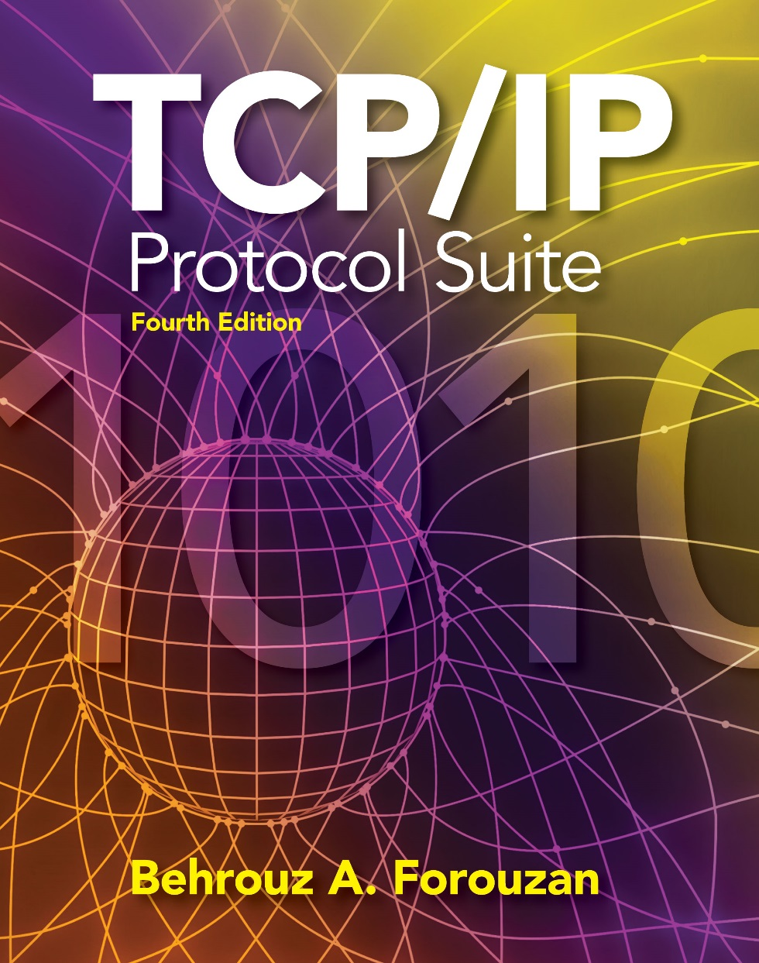
Chapter 15
Transmission
Control
Protocol
(TCP)
Copyright © The McGraw-Hill Companies, Inc. Permission required for reproduction or display.

Slide 2
OBJECTIVES:
To introduce TCP as a protocol that provides reliable stream delivery service.
To define TCP features and compare them with UDP features.
To define the format of a TCP segment and its fields.
To show how TCP provides a connection-oriented service, and show the segments exchanged during connection establishment and connection termination phases.
To discuss the state transition diagram for TCP and discuss some scenarios.
To introduce windows in TCP that are used for flow and error control.

Slide 3
OBJECTIVES (continued):
To discuss how TCP implements flow control in which the receive window controls the size of the send window.
To discuss error control and FSMs used by TCP during the data transmission phase.
To discuss how TCP controls the congestion in the network using different strategies.
To list and explain the purpose of each timer in TCP.
To discuss options in TCP and show how TCP can provide selective acknowledgment using the SACK option.
To give a layout and a simplified pseudocode for the TCP package.

Slide 4
Chapter
Outline
15.1 TCP Services
15.2 TCP Features
15.3 Segment
15.4 A TCP Connection
15.5 State Transition Diagram
15.6 Windows in TCP
15.7 Flow Control
15.8 Error Control
15.9 Congestion Control
15.10 TCP Timers
15.11 Options
15.12 TCP Package

Slide 5
15-2 TCP FEATURES
To provide the services mentioned in the previous section, TCP has several features that are briefly summarized in this section and discussed later in detail.

Slide 6
Topics Discussed in the Section
Numbering System
Flow Control
Error Control
Congestion Control

Slide 7

Numbering System
Byte Number
Sequence Number
Acknowledgment Number

Slide 8

Note
The bytes of data being transferred in each connection are numbered by TCP.
The numbering starts with an arbitrarily generated number.

Slide 9
Example 15.1
Suppose a TCP connection is transferring a file of 5,000 bytes. The first byte is numbered 10,001. What are the sequence numbers for each segment if data are sent in five segments, each carrying 1,000 bytes?
Solution
The following shows the sequence number for each segment:

Slide 10
Note
The value in the sequence number
field of a segment defines the number assigned to the first data byte
contained in that segment.

Slide 11
Note
The value of the acknowledgment field in a segment defines the number of the next byte a party expects to receive.
The acknowledgment number is cumulative.

Slide 12
END of TCP Features

